Slide 1
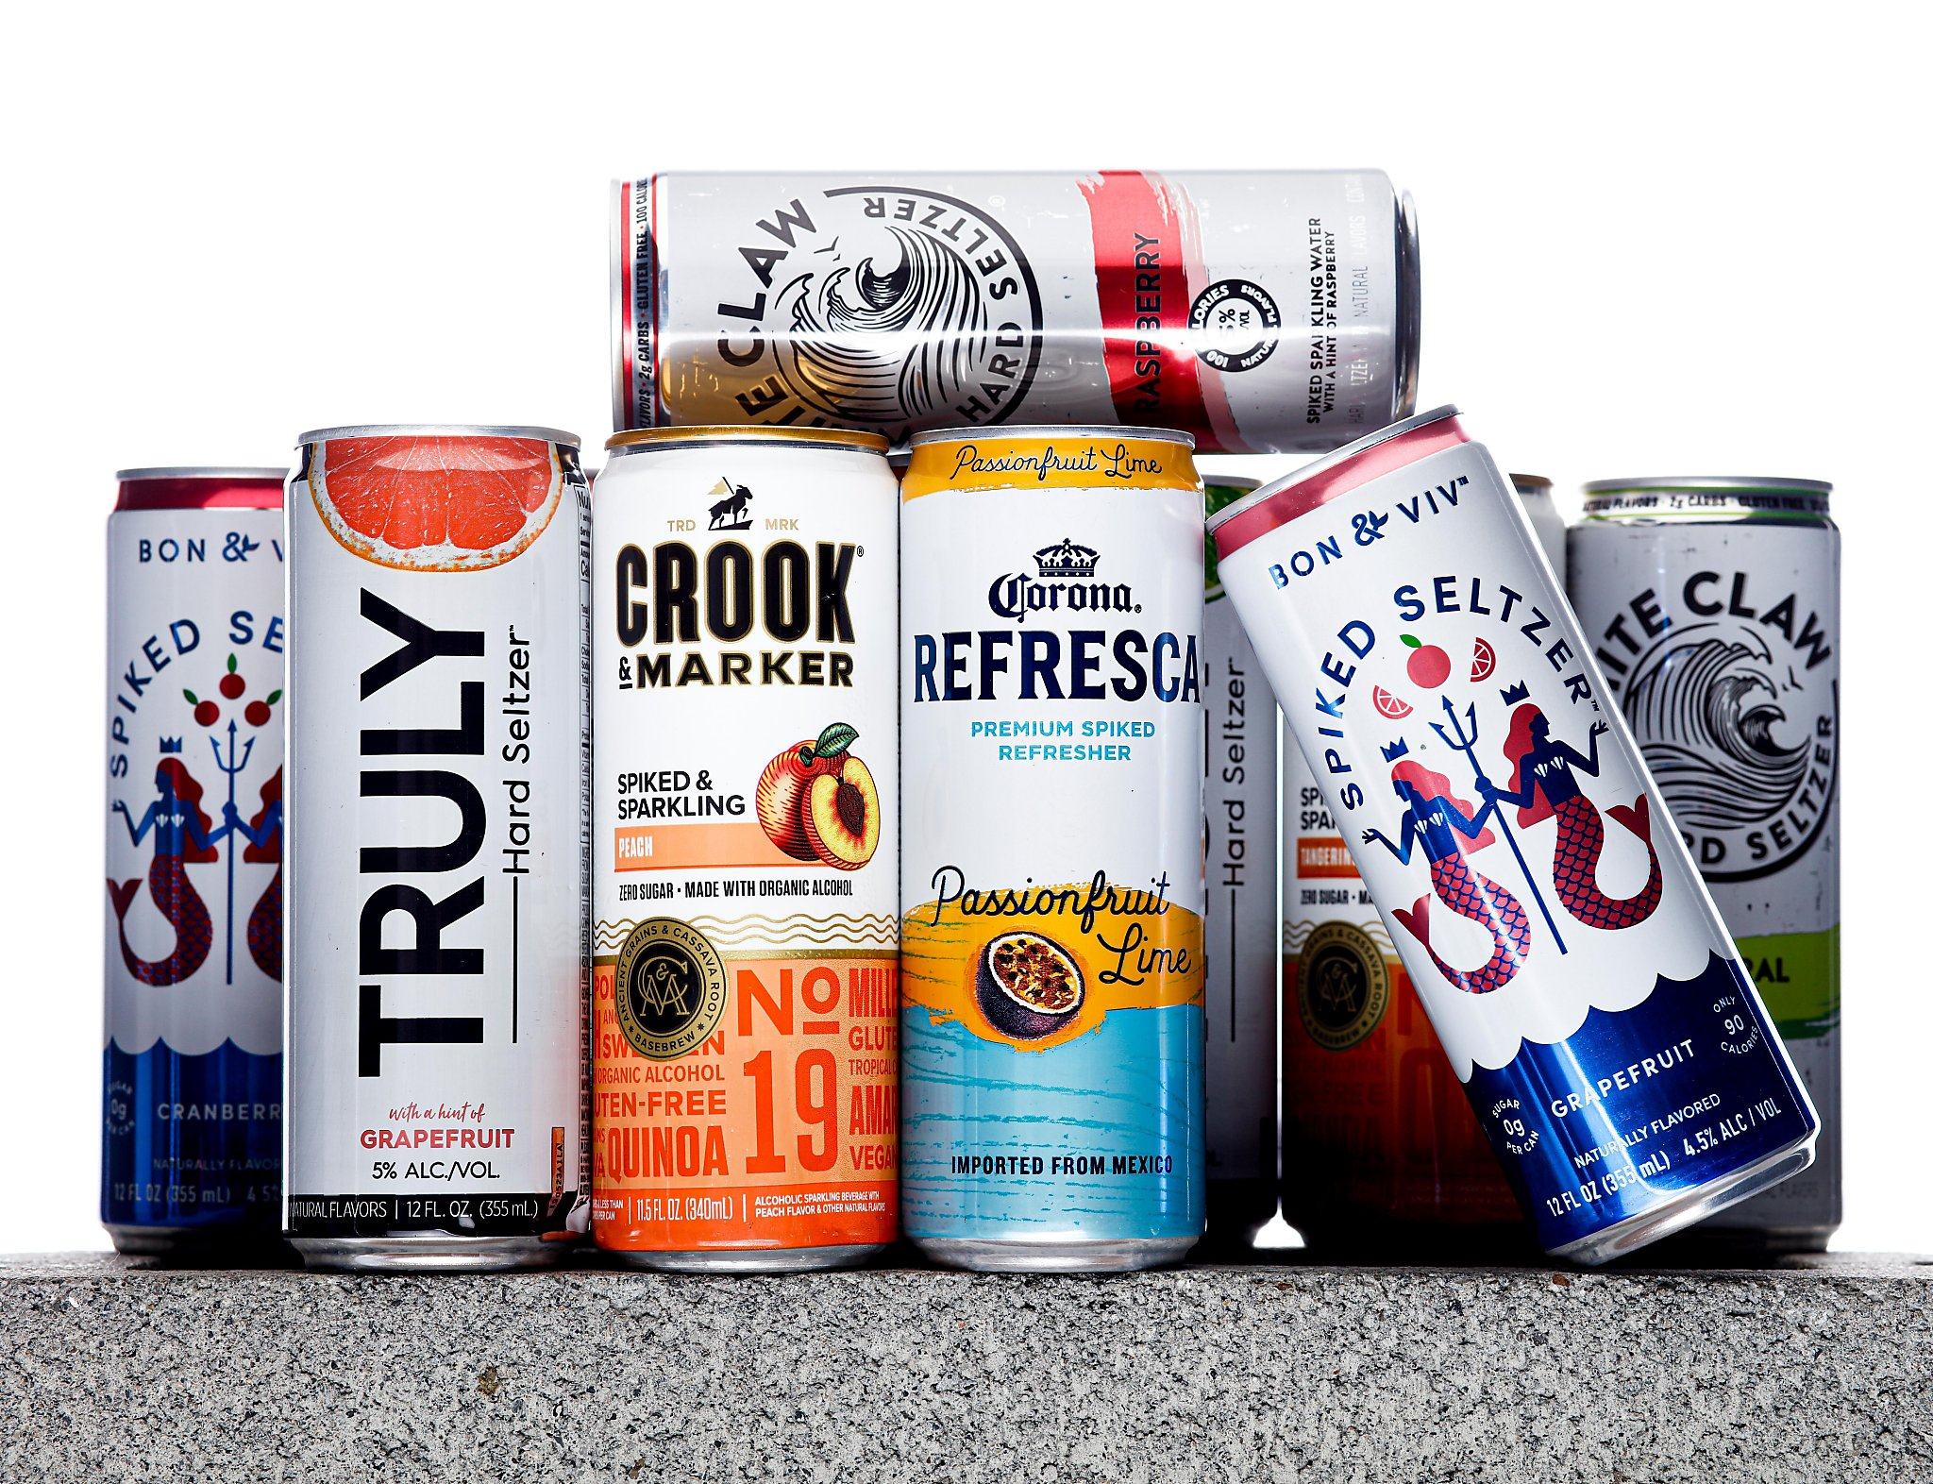
Viva
Hard Seltzer: Profitability and Sustainability Analysis of an Ideal Hard Seltzer Product
Viva
Hard Seltzer
EMSE 6099 - FINAL PRESENTATION
APRIL 19, 2022
Sivakumaar, Kampouris, Lane, Langarica

Slide 2
Roadmap
INTRODUCTION
RESEARCH
FURTHER RESEARCH
1
3
5
2
4
6
BACKGROUND
APPROACH & FINDINGS
CONCLUSION
Notes:
Myrto

Slide 3
INTRODUCTION
1
Notes:
Myrto

Slide 4
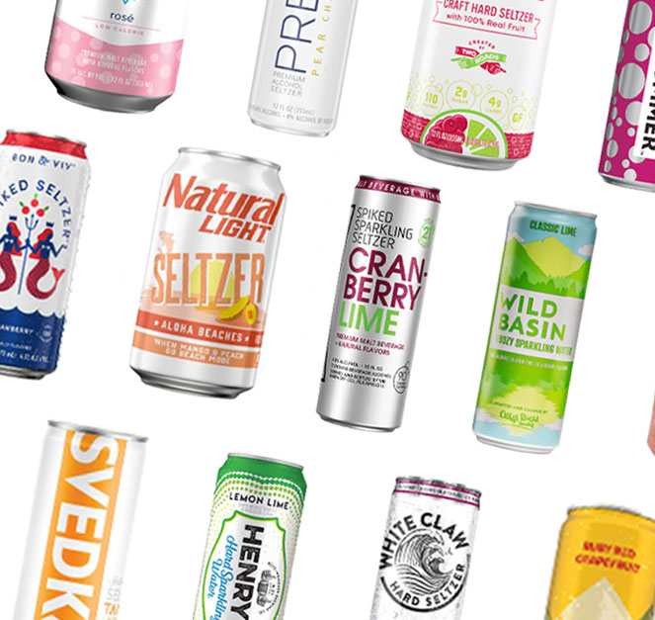
Hard Seltzers
What are they?
Popular alcoholic beverages combining alcohol with flavored carbonated water
Low in alcohol, sugar, and calories compared to other alcoholic beverages
Market
Booming: growing annually by 60% in 2021 to $8.8 billion, and expected to grow at a compound annual growth rate of 21.7% through 2030
New brands and expansion of existing brands into the hard seltzer industry
Combination of Product Attributes
Price
Calories
Vitamins
Sugar
Alcohol
Packaging Material
Notes:
Myrto
growing annually by 60% in 2021 to $8.8 billion, and expected to grow at a compound annual growth rate of 21.7% through 2030².

Slide 5
Objective
To create a profitable hard seltzer whose production process considers the environmental impact of its primary packaging materials.
Notes:
Myrto

Slide 6
BACKGROUND
2

Slide 7
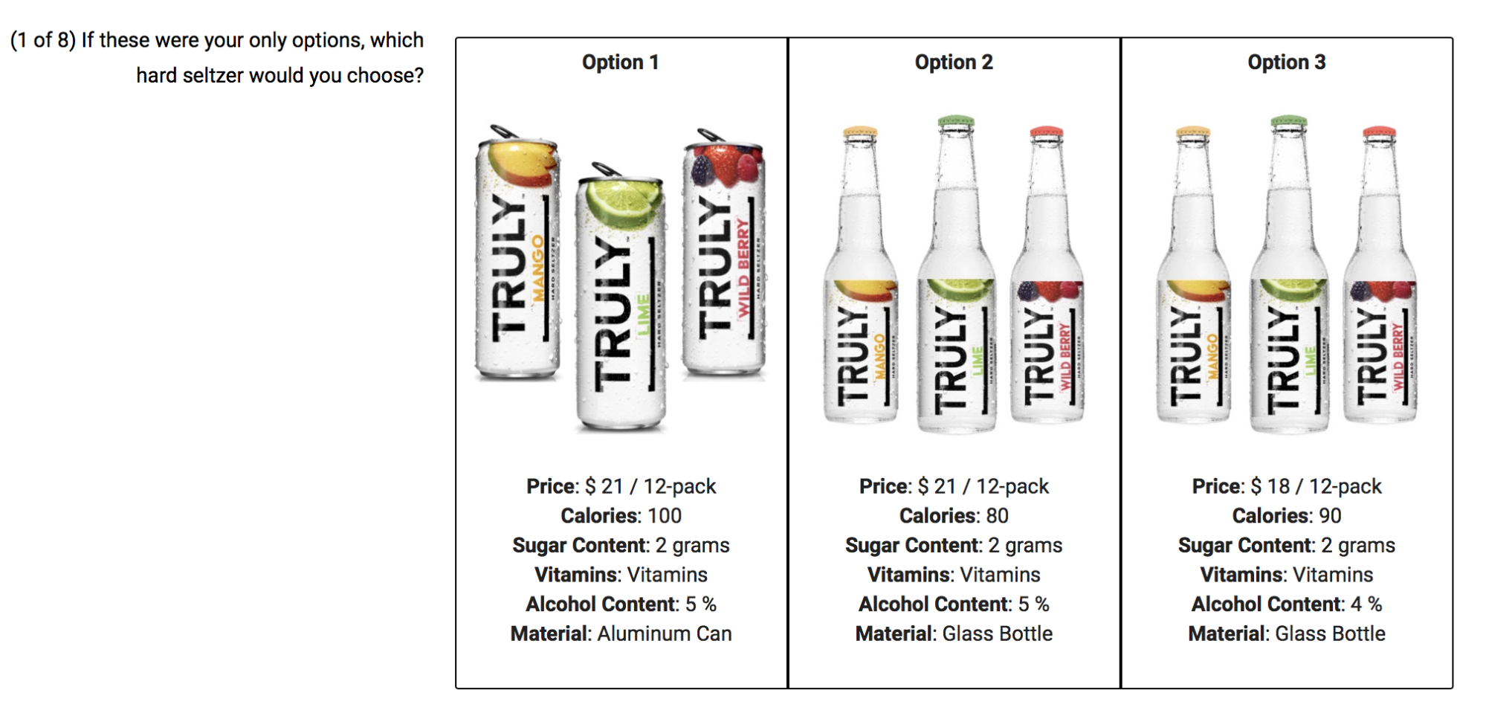
Previous Work ~ Market Analytics Project
Survey (220 clean samples)
Goal: Assess which combination of attributes is most lucrative for a new line of premium hard seltzers via Conjoint Survey.
Simulation
Market Share Simulation using R code and
Conjoint Survey data
Final Recommendation
Maintain a low, competitive price while also prioritizing the production of a high alcohol content, low-calorie hard seltzer
Notes:
Myrto

Slide 8
RESEARCH
3
Notes:
Javi

Slide 9
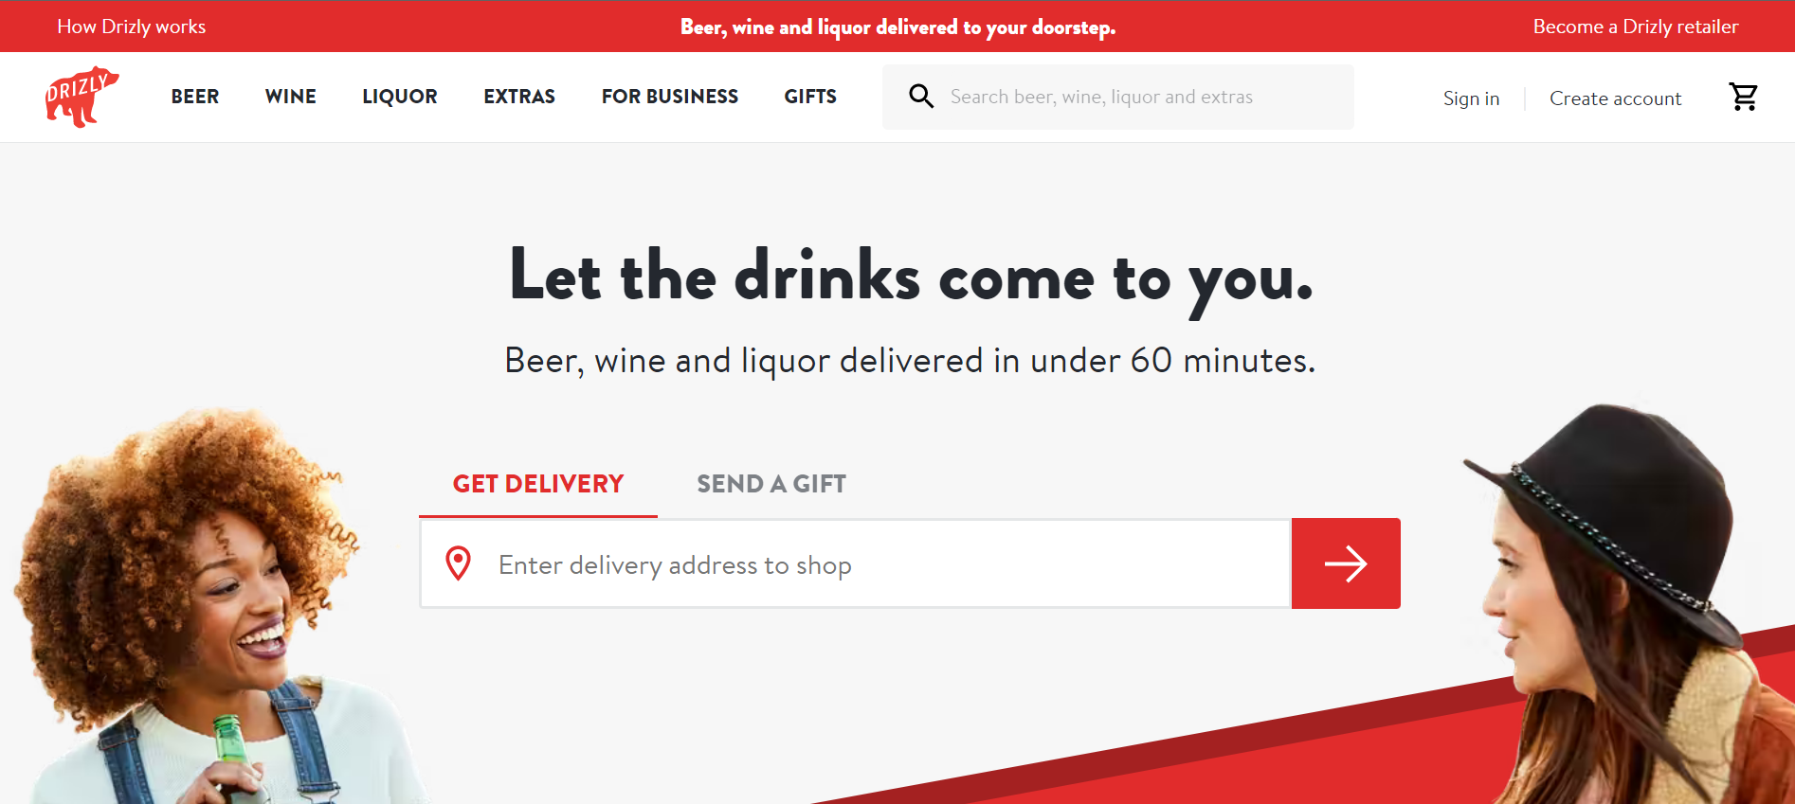
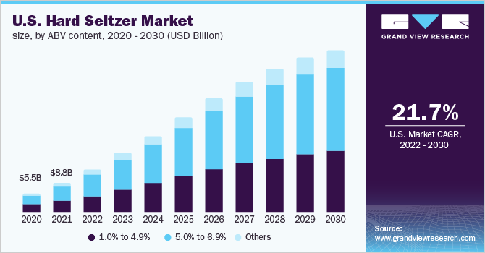
RESEARCH
Product data
Collection of attributes for top 30 12-pack
hard seltzer products
Zero products with glass bottles
Market data
Global hard seltzer market size : $8.85B
North America: 55.5% of global market
Compound Annual Growth Rate (CAGR): 21.7%
Notes:
Javi

Slide 10
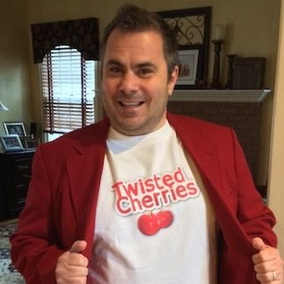

INTERVIEWS
Larry Trachtenbroit
More than 10 years in the alcohol industry
Launched his own product Alc-A-Chino (spiked iced coffee)
Main takeaways:
Eco labels would probably not have much traction
Creation and distribution of a product are two very different things
Madison Reinker
Sr. Manager, Supply Network Planning, Supply Chain
Optimization at Anheuser-Busch
B.S. & M.S. in Systems Engineering at George Washington U.
Main takeaways:
Aluminum cans are always more affordable
Percent of glass recycled depends on glass recovered
Emission differences stem from transportation logistics
Higher-priced products may not obtain large market share, but achieve higher margins per unit
Notes:
Javi

Slide 11
APPROACH & FINDINGS
4
Notes:
Vysaaly

Slide 12
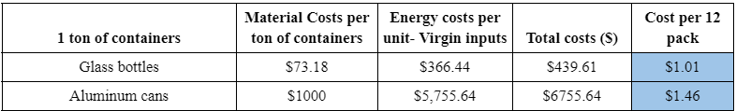
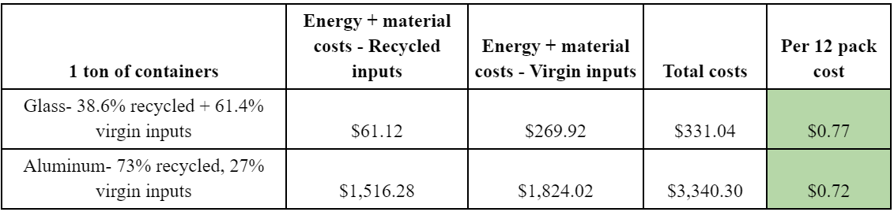
PRODUCTION COSTS
Aluminum costs 45% more
Aluminum costs 5.89% less
Notes:
Vysaaly

Slide 13
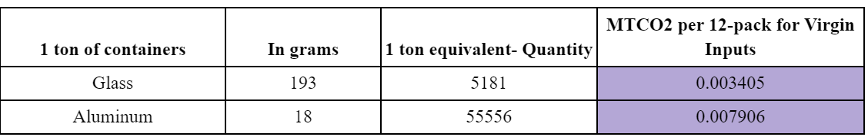
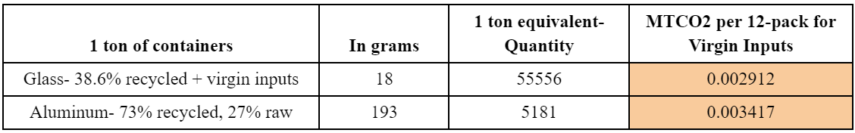
CO2 EMISSIONS FROM PRODUCTION
Aluminum emits 132.16% more
Aluminum emits 17.36% more
Notes:
Vysaaly

Slide 14
FRAMING THE FORECAST
Length of Forecast: 8 years (2021-2028)
Annual Market Growth: 21.7%
Annual Competitor Growth: 10.85%
Future Competitors: Randomly generated combinations of attribute levels from current market sample
Discount Rate: 8.68%
Average WACC of the five biggest publicly traded companies that have at least one hard seltzer product
Year | Year (number) | North America Hard Seltzer Market | Competitors (products) | Number of simulated competitors (from year 0)
2021 | 0 | $4,939,500,000.00 | 31 | 0
2022 | 1 | $6,011,371,500.00 | 34 | 3
… | … | … | … | …
2028 | 7 | $19,530,665,293.98 | 59 | 28
Notes:
Christian

Slide 15
7.
Reusable glass bottles at a recovery rate of 19.3%
1.
Aluminium cans produced using virgin inputs
$19
$22
$17
$19
6.
Reusable glass bottles at a recovery rate of 38.6%
2.
Aluminum cans produced using 73% recycled inputs
HARD SELTZER ALTERNATIVES
(14 Total)
$19
$22
$17
$19
5.
Glass bottles produced using 65% of recovered inputs
3.
Glass bottles produced using virgin inputs
$19
$22
4.
Glass bottles produced using 38.5% of recovered bottles from the previous year’s gen
$19
$22
Industry standard in the US
Average recovery rate of glass bottles in the US
Recovery rate in states with deposit centers
$19
$22
Notes:
Christian
1. Aluminum cans produced using virgin inputs,
2. Aluminum cans produced using 73% recycled inputs (industry standard in the U.S),
3. Glass bottles produced using virgin inputs,
4. Glass bottles produced using 38.6% of recovered bottles from the previous year’s generation (average recovery rate of glass bottles in the U.S)⁶,
5. Glass bottles produced using 65% recovered inputs (recovery rate in states with deposit centers)⁶,
6. Reusable glass bottles at a recovery rate of 38.6%, and
7. Reusable glass bottles at a recovery rate of 19.3%.

Slide 16
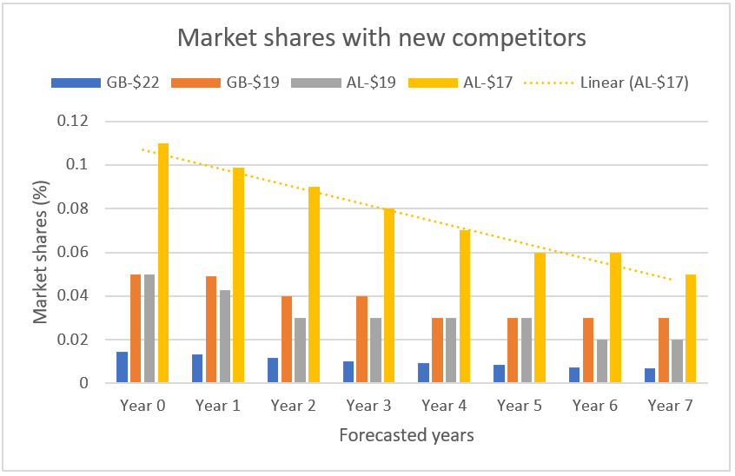
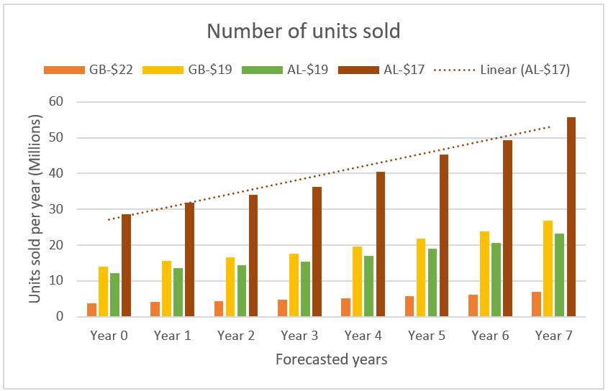
FORECASTED MARKET SHARES & DEMAND PER YEAR
Market Shares with Adding Competitors
Number of Units Sold
Market shares declines as number of competitors increases
Units sold increases as market size grows (by 21.7%)
Notes:
Vysaaly

Slide 17
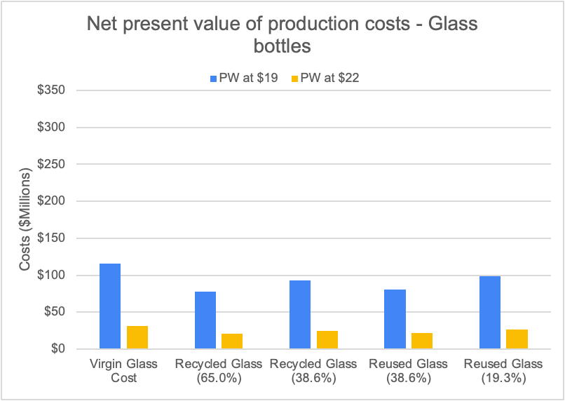
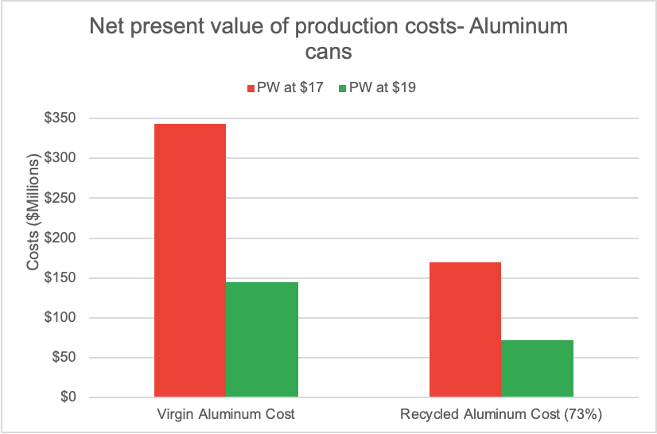
FORECASTED PRODUCTION COST
NPV of Production Costs - Glass Bottles
NPV of Production Costs - Aluminium Cans
Virgin glass at $19 - $116Mn (highest)
Recycled glass at 65%- lowest cost in both
Virgin AL cans at $17 - $343Mn (highest)
Recycled AL cans have lower costs
Notes:
Vysaaly

Slide 18
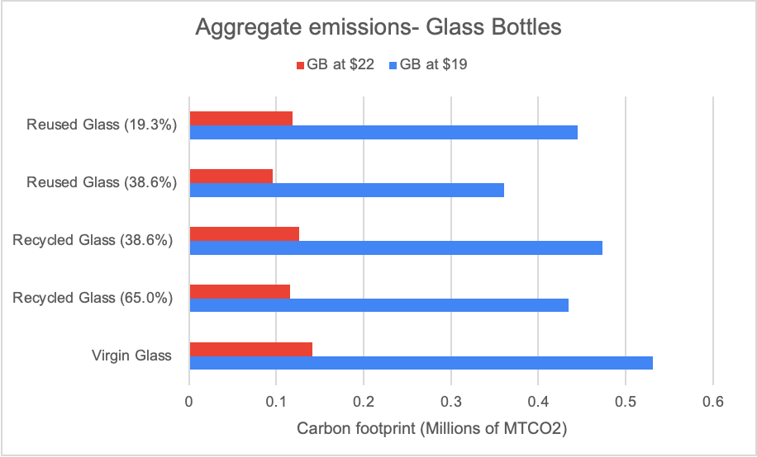
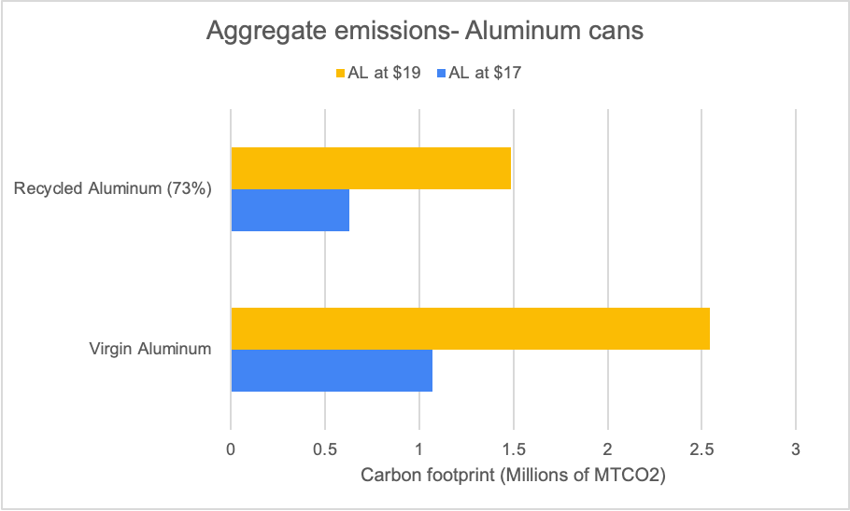
FORECASTED EMISSIONS
Aggregate Emissions - Glass Bottles
Aggregate Emissions - Aluminium Cans
Virgin glass at $19 - 0.53Mn MTCO2 (highest)
Reused glass at 38.6%- lowest emissions in both
Virgin AL cans at $19 - 2.54 Mn MTCO2 (highest)
Recycled AL cans - lower emission in both
Notes:
Vysaaly
The lowest emissions of AL cans are still higher than the highest emitting production of glass bottles

Slide 19
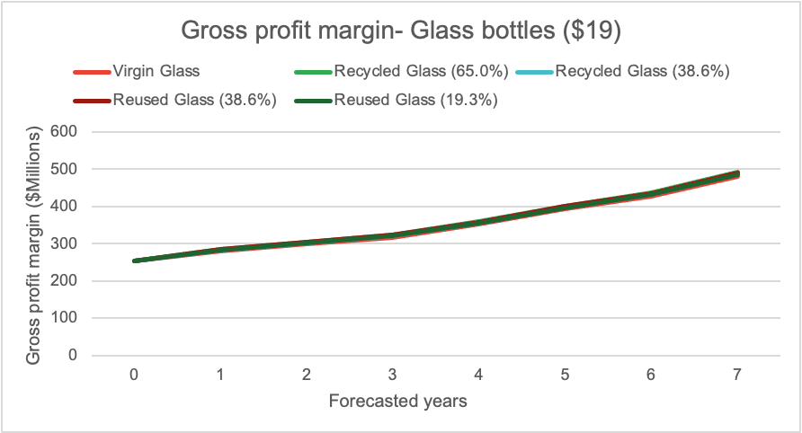
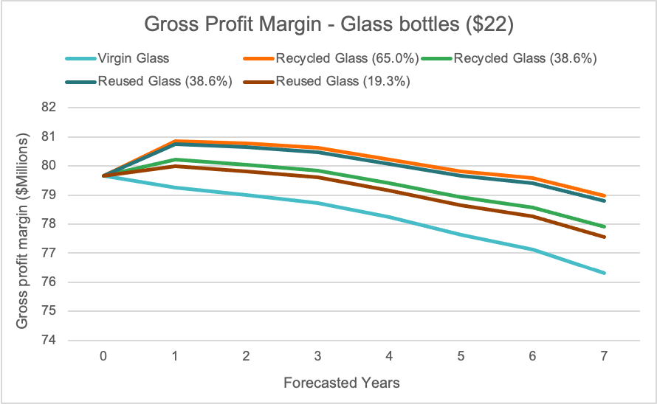
GROSS PROFIT MARGIN
Gross Profit Margin - Glass bottles ($19)
Gross Profit Margin - Glass bottles ($22)
Steady increase- 100% increase from year 0 to 7
Decline after year 1- 2.5% drop from year 1 to 7
Notes:
Javi

Slide 20
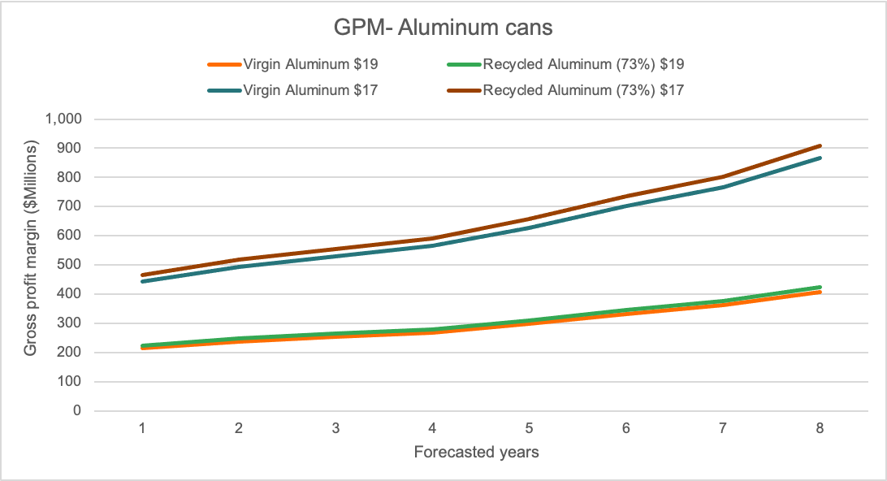
GROSS PROFIT MARGIN
Gross Profit Margin - Aluminium cans
$907Mn
$425Mn
100% increase from year 0 to 7 for both alternatives
Notes:
Javi

Slide 21
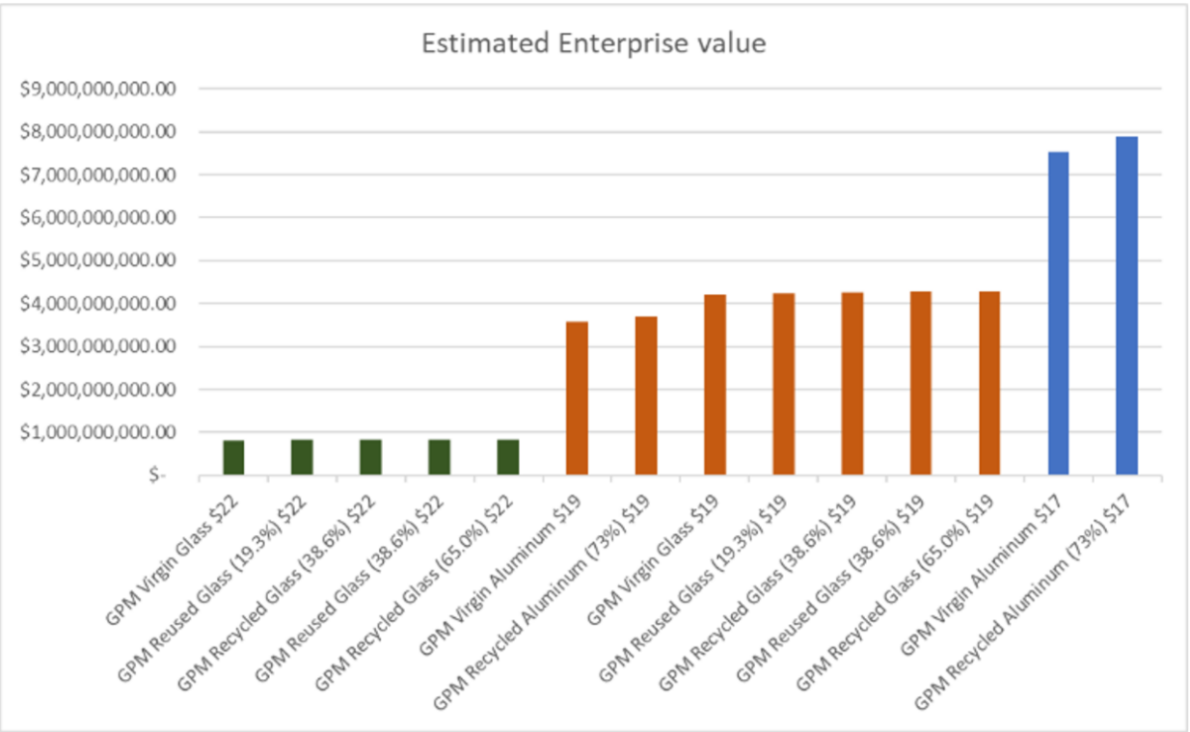
NET PRESENT VALUE BY ALTERNATIVE
Gross Profit Margin (NPV at 8.68%)
Notes:
Javi

Slide 22
MULTI-ATTRIBUTE UTILITY MODEL
Alternative | NPV Gross Profit Margin ($Billion) | Agg. CO2 Emissions (Millions MTCO2) | GPM Utility | Aggregate CO2 Emissions Utility
(1) Virgin Glass $19 | $4.202 | .530 | 0.47927 | 0.82225
(2) Recycled Glass (65.0%) $19 | $4.285 | 0.434 | 0.49110 | 0.86170
(3) Recycled Glass (38.6%) $19 | $4.251 | 0.473 | 0.48629 | 0.84568
(4) Reused Glass (38.6%) $19 | $4.279 | 0.361 | 0.49025 | 0.89161
(5) Reused Glass (19.3%) $19 | $4.241 | 0.444 | 0.48476 | 0.85747
(6) Virgin Glass $22 | $0.818 | 0.141 | 0 | 0.98153
(7) Recycled Glass (65.0%) $22 | $0.840 | 0.115 | 0.00313 | 0.99203
(8) Recycled Glass (38.6%) $22 | $0.831 | 0.125 | 0.00186 | 0.98777
(9) Reused Glass (38.6%) $22 | $0.839 | 0.095 | 0.00291 | 1
(10) Reused Glass (19.3%) $22 | $0.828 | 0.118 | 0.00145 | 0.99091
(11) Virgin Aluminum $19 | $3.564 | 1.072 | 0.38898 | 0.60092
(12) Recycled Aluminum (73%) $19 | $3.714 | 0.628 | 0.41022 | 0.78256
(13) Virgin Aluminum $17 | $7.521 | 2.543 | 0.94942 | 0
(14) Recycled Aluminum (73%) $17 | $7.878 | 1.489 | 1 | 0.43068
Best Value | $7.878 | 0.095
Worst Value | $0.818 | 2.543
Notes:
Christian

Slide 23
MULTI-ATTRIBUTE UTILITY MODEL
Alternative | Total Weighted Utility | Utility Rank (Highest-Lowest)
(1) Virgin Glass $19 | 0.65076 | 6
(2) Recycled Glass (65.0%) $19 | 0.67640 | 3
(3) Recycled Glass (38.6%) $19 | 0.66598 | 5
(4) Reused Glass (38.6%) $19 | 0.69093 | 2
(5) Reused Glass (19.3%) $19 | 0.67111 | 4
(6) Virgin Glass $22 | 0.49076 | 13
(7) Recycled Glass (65.0%) $22 | 0.49758 | 9
(8) Recycled Glass (38.6%) $22 | 0.49481 | 12
(9) Reused Glass (38.6%) $22 | 0.50145 | 8
(10) Reused Glass (19.3%) $22 | 0.49618 | 10
(11) Virgin Aluminum $19 | 0.49495 | 11
(12) Recycled Aluminum (73%) $19 | 0.59639 | 7
(13) Virgin Aluminum $17 | 0.47471 | 14
(14) Recycled Aluminum (73%) $17 | 0.71534 | 1
Utility Weights | Profitability (Gross Profit Margin) | Sustainability (Aggregate CO2 Emissions)
 | 0.50 | 0.50
Notes:
Christian

Slide 24
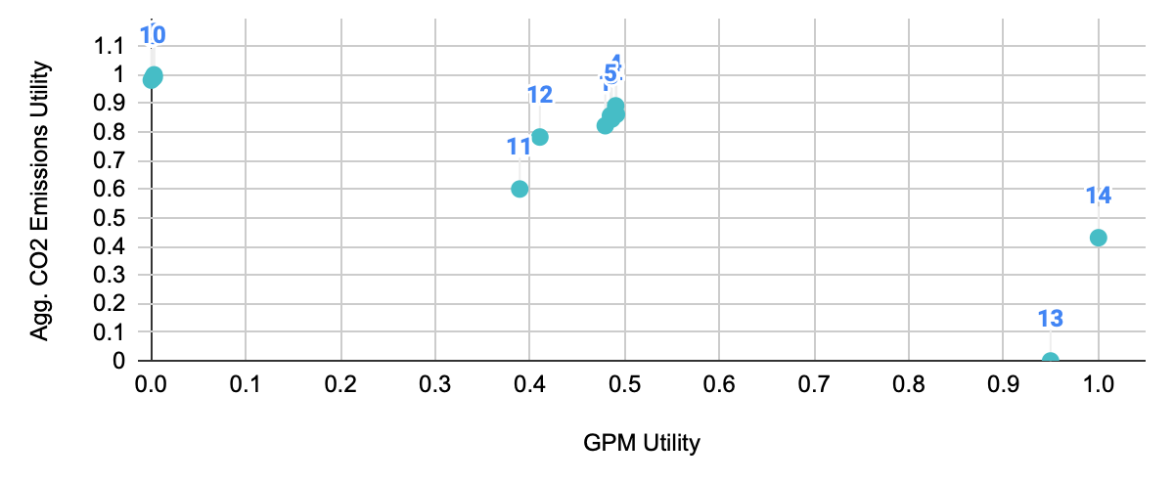
PROFITABILITY-SUSTAINABILITY EFFICIENT FRONTIER
9
4
14
Best-sustainable:
(9) Reused Glass (38.6%) $22
Best-balanced:
(4) Reused Glass (38.6%) $19
Best-profitable:
(14) Recycled Aluminum (73%) $22
Notes:
Christian
This indicates that Alternative 9 ($22 Glass Bottle with 38.6% Reused Glass) is the optimal alternative for maximizing sustainability (minimizing carbon footprint), Alternative 4 ($19 Glass Bottle with 38.6% Reused Glass) is the optimal alternative for marginally prioritizing sustainability over profitability, and Alternative 14 ($17 Aluminum Can with 73% recycled material) is the optimal alternative for marginally-to-totally favoring profitability over sustainability.

Slide 25
FUTURE RESEARCH
5
Notes:
Myrto

Slide 26
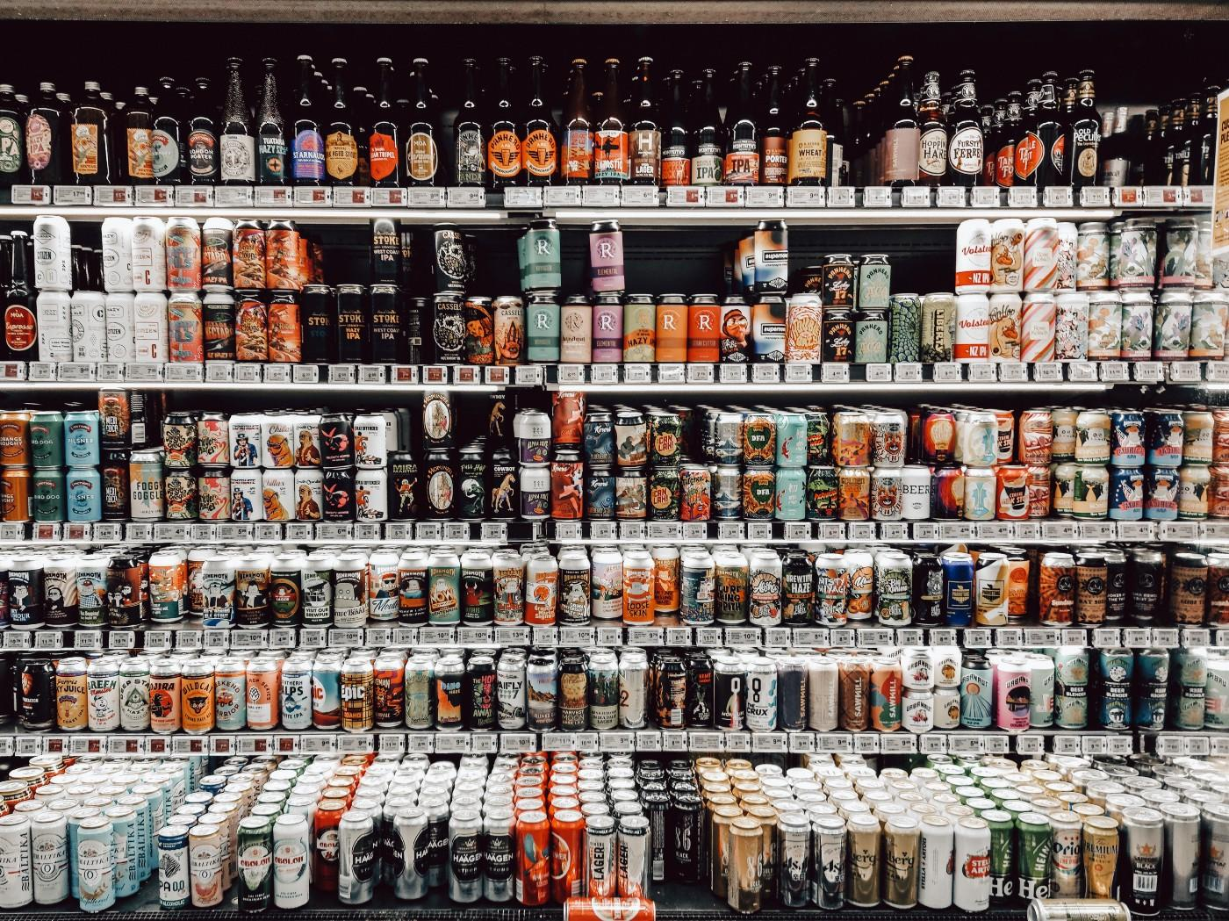
FOOD (DRINK) FOR THOUGHT
Transportation & Distribution Cost & Logistics
Feasibility of low-price seltzer alternatives
Government assistance or Lobbying for Reuse/Recycling Programs
Connecting results to ESG & Eco-Labels
Notes:
Myrto

Slide 27
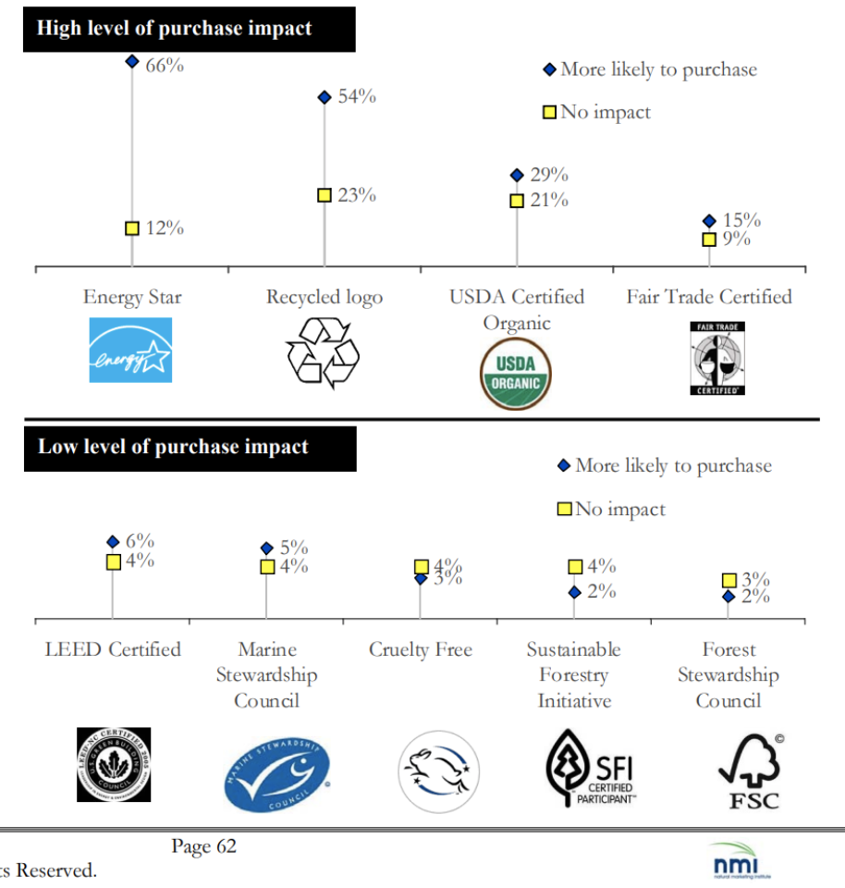




ECO LABELS
Global Recycle Standard
Recycled Content
SCS Recycled Content
TerraCycle
Notes:
Vysaaly

Slide 28
CONCLUSION
6
Notes:
Christian

Slide 29
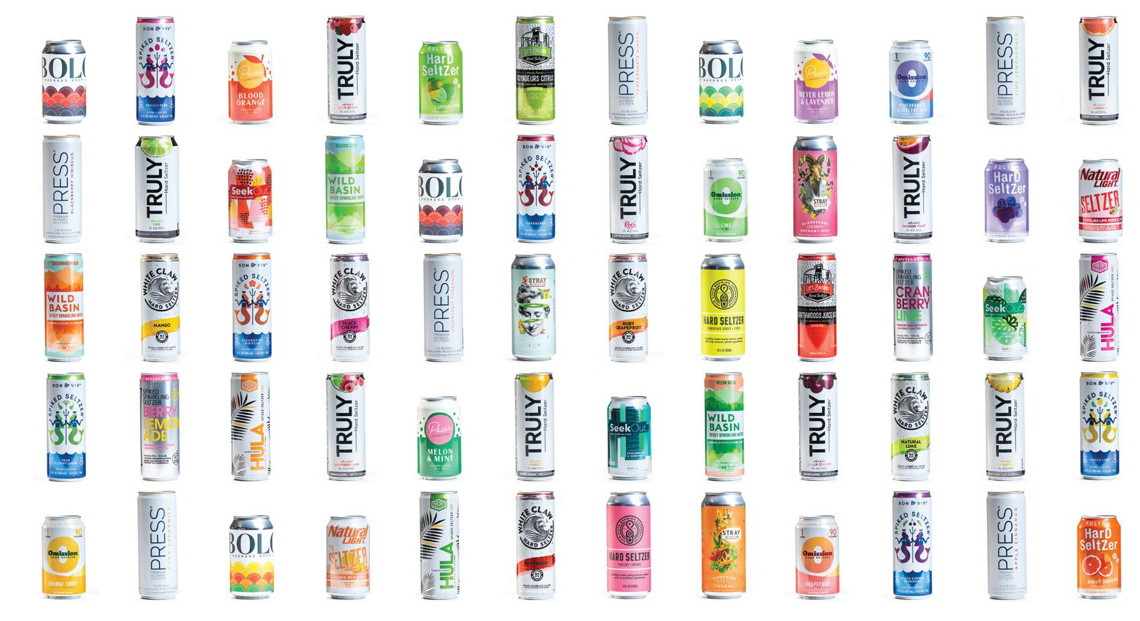
CONCLUSION
Glass bottles provide long-term sustainability benefits relative to aluminum cans
Selling price drives product market share
Marginal market share benefits (e.g. glass bottle packaging) create significant long-term differences in profitability
Potential for circular economic programs to deliver significant advantages in both profitability and sustainability… so long as they be implemented
Notes:
Christian

Slide 30
Thank
you!
Any questions?
References available via Final Report

Slide 31
APPENDIX
8
Notes:
Christian

Slide 32
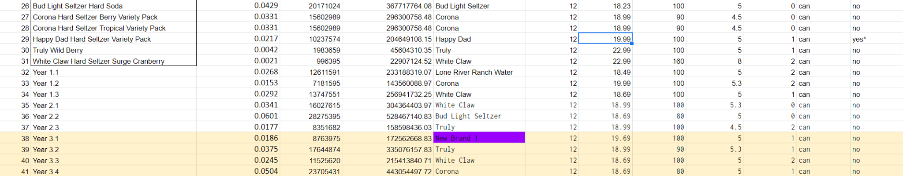
NEW COMPETITORS
………………………………………………………………………………………………………………………………………………………………………………………………………………………………………………..

Slide 33
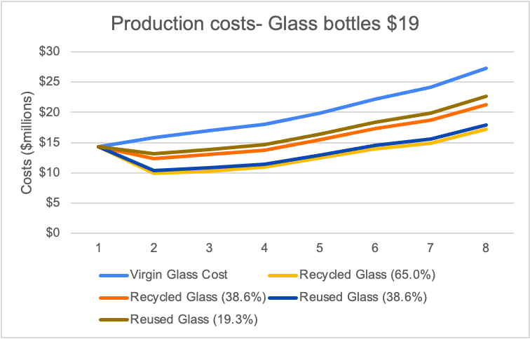
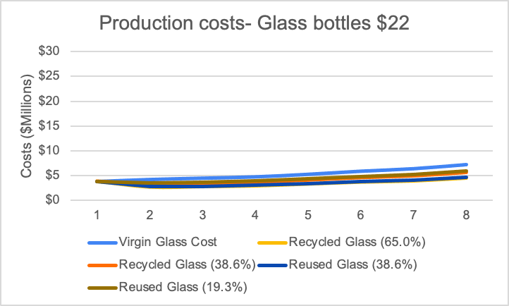
FORECASTING PRODUCTION COST

Slide 34
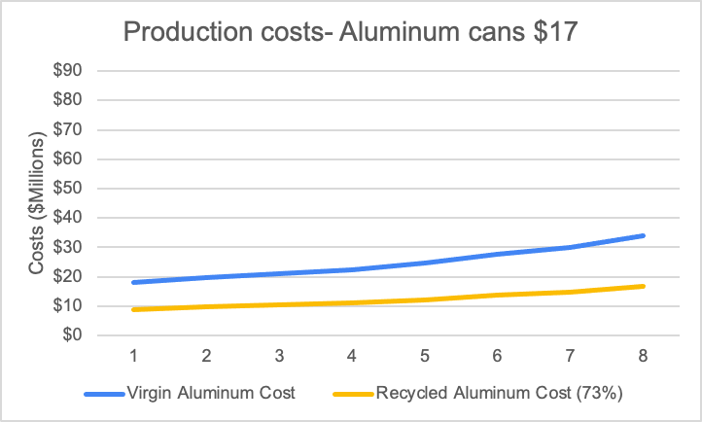
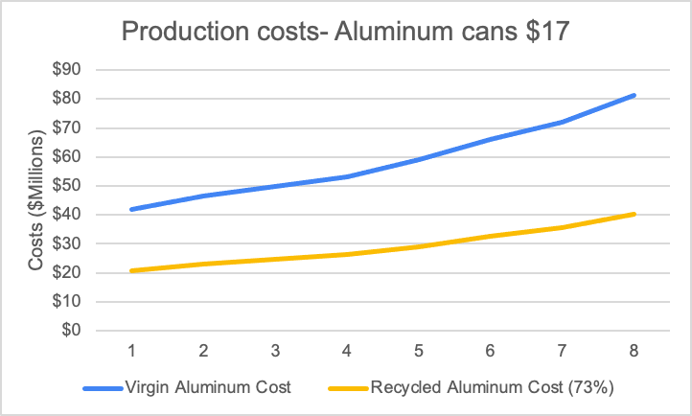
FORECASTING PRODUCTION COST

Slide 35
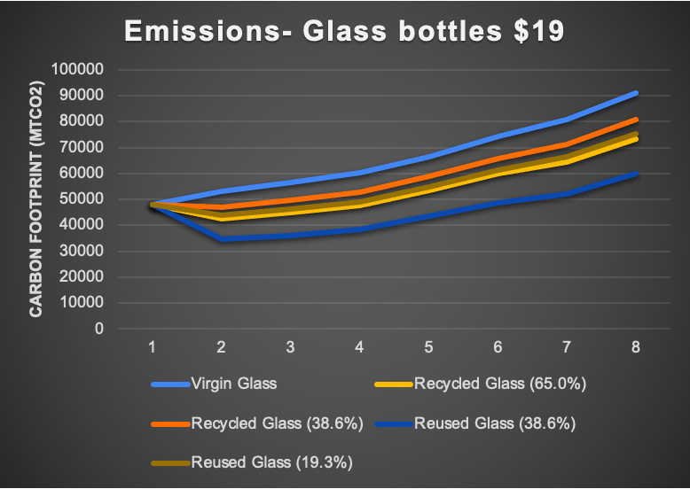
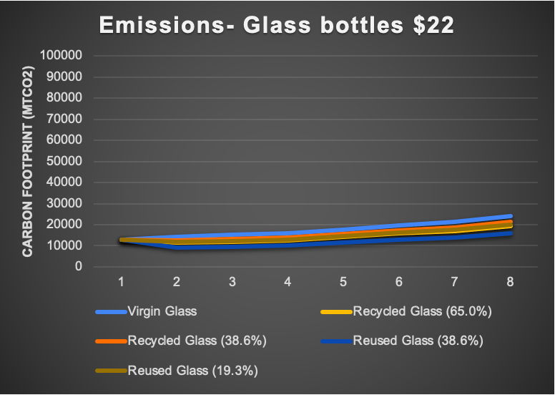
FORECASTING EMISSIONS

Slide 36
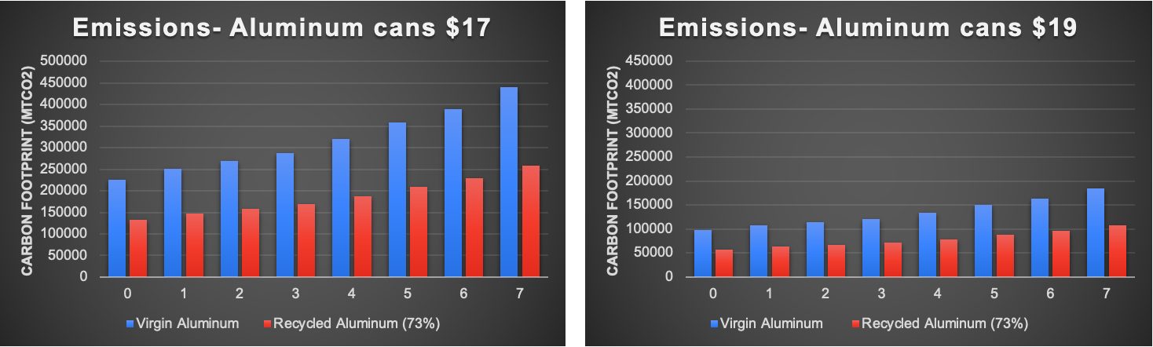
FORECASTING EMISSIONS

